Slide 1
Digital transformation of production plant
Industry 4.0 solutions for production
Based on: "Current Standards Landscape for Smart Manufacturing Systems"
http://dx.doi.org/10.6028/NIST.IR.8107

Slide 2
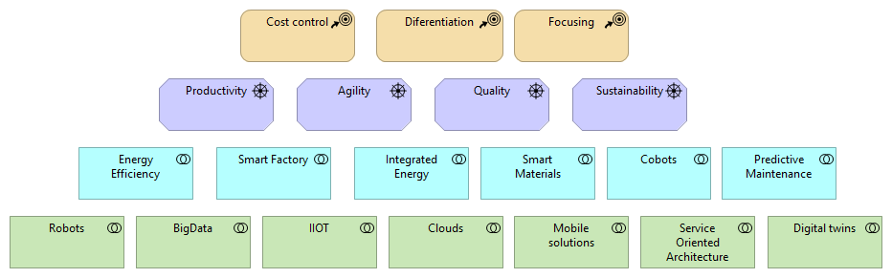
Enterprise strategy defines digitalization projects portfolio

Slide 3
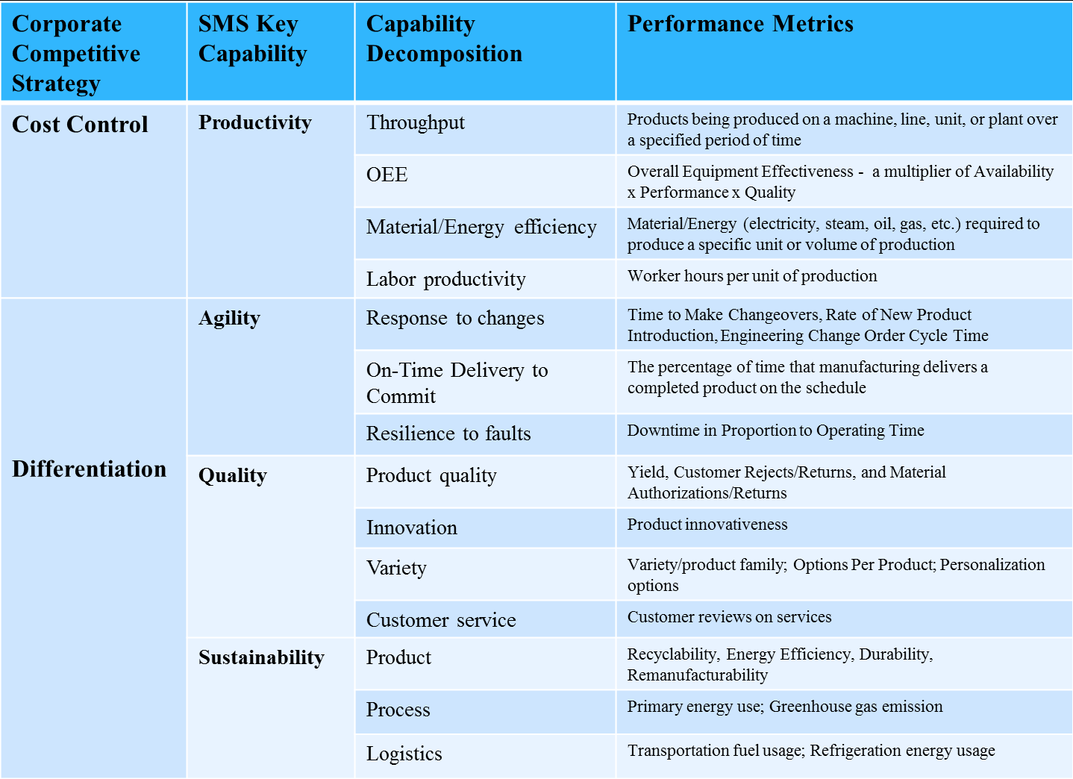
Strategy -> Capabilities -> KPIs -> Solutions Old rationale approving way for new technologies

Slide 4
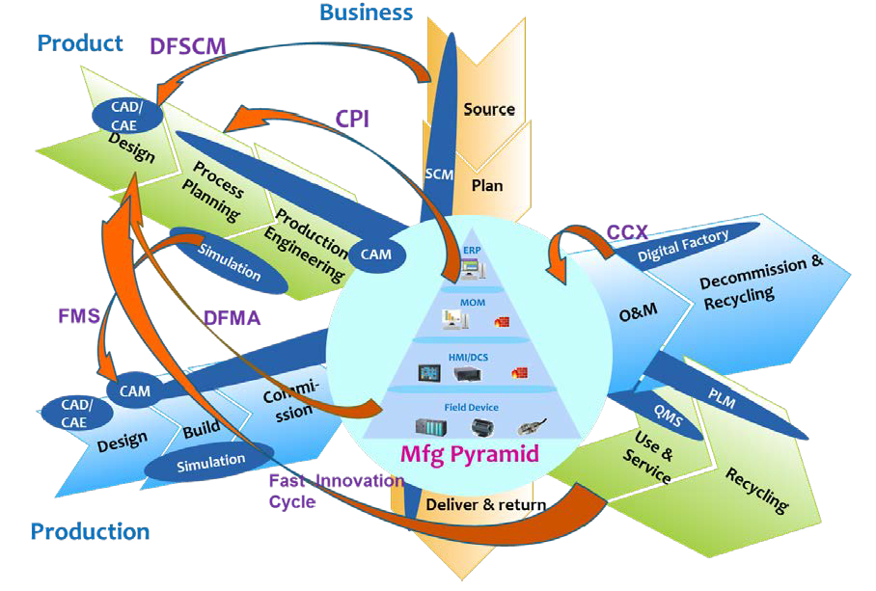
Three major dimensions of DX program

Slide 5
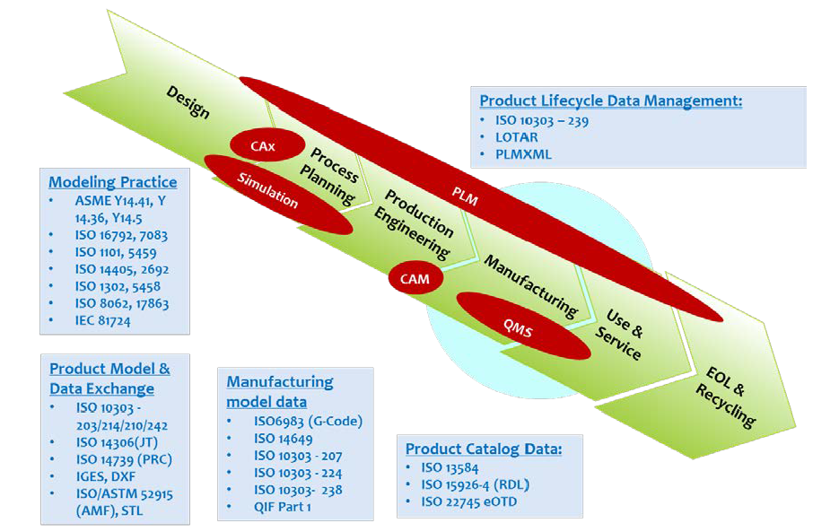
Product dimension – for differentiation and focusing strategies

Slide 6
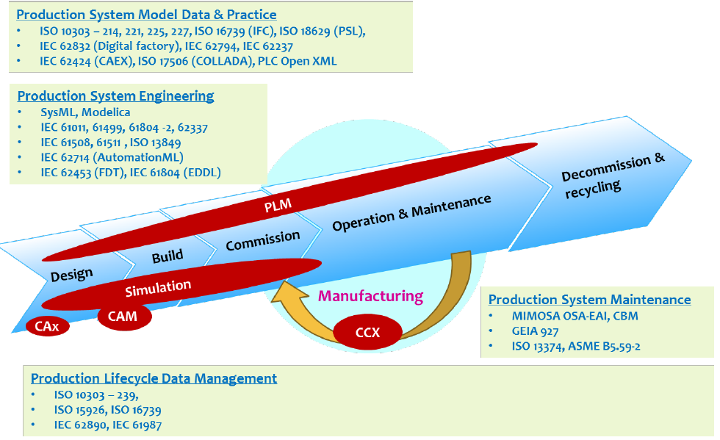
Any kind of production enterprise needs appropriate equipment digitalization

Slide 7
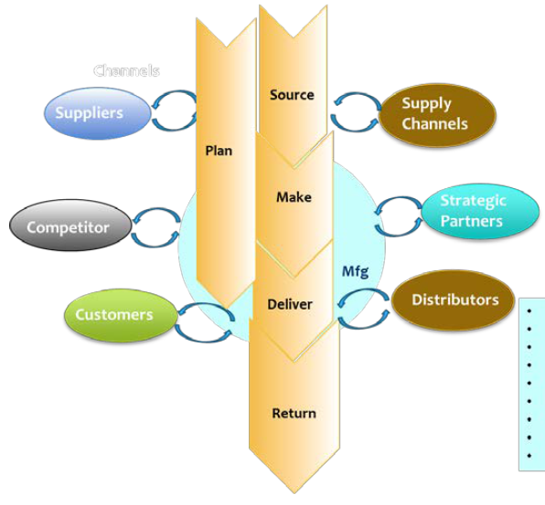
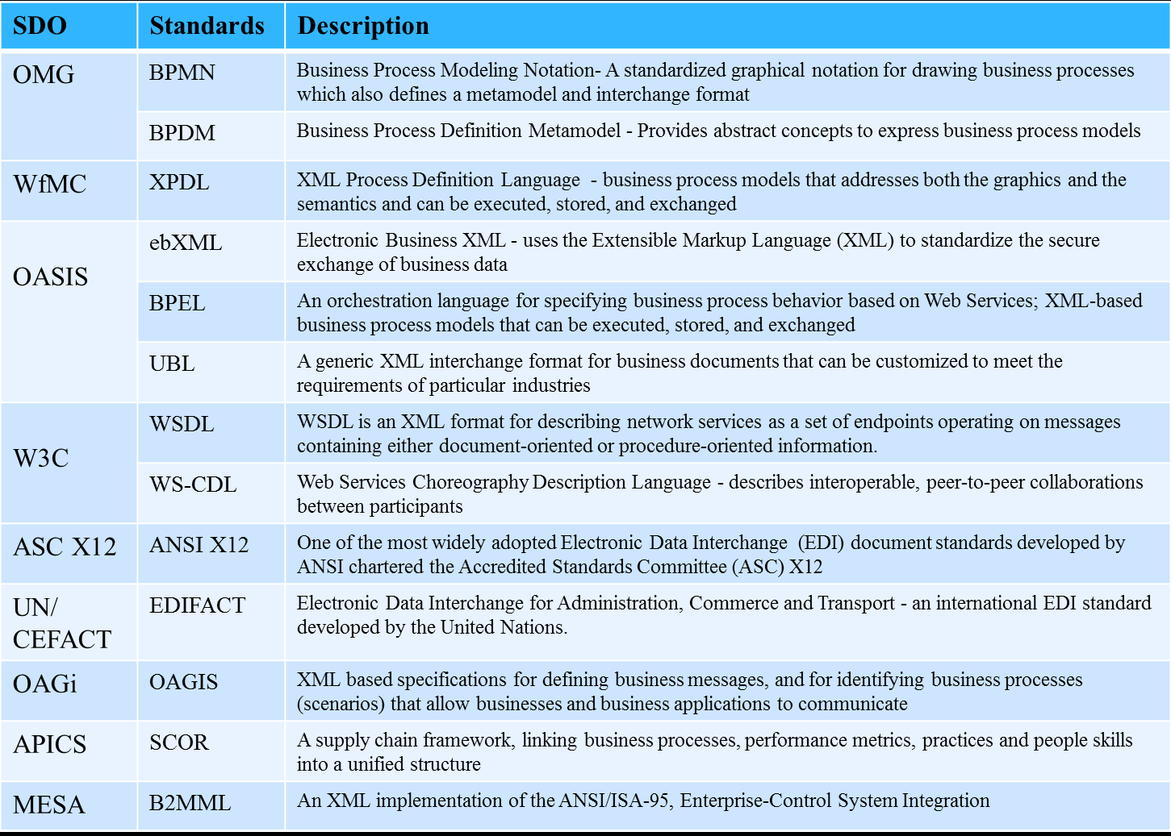
Connected enterprise – standards set for horizontal integration

Slide 8
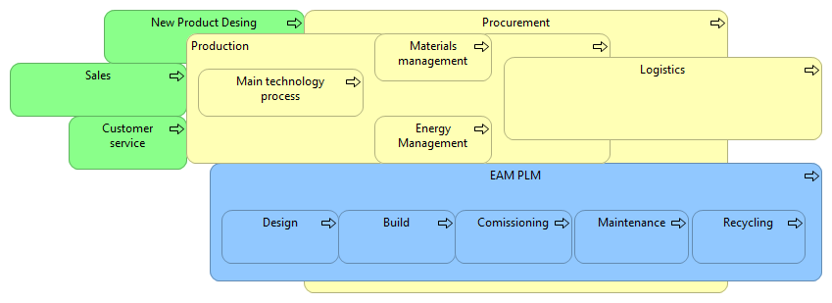



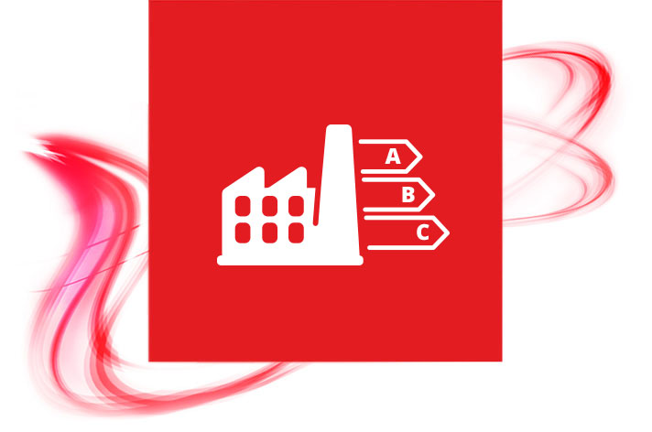


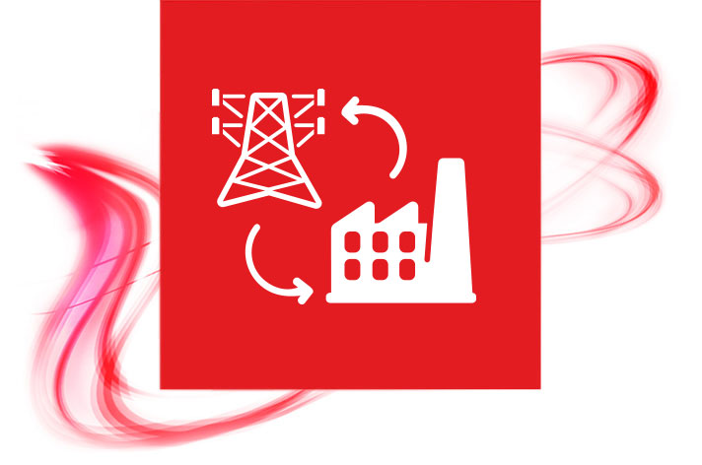
Mapping above to generalized business processes of production plant we see possible applications for I4.0 at production plant
CPS Interaction
Smart materials
Integrated Energy
Digital Twins
Predictive Maintenance
Energy Efficiency
Cobots

Slide 9
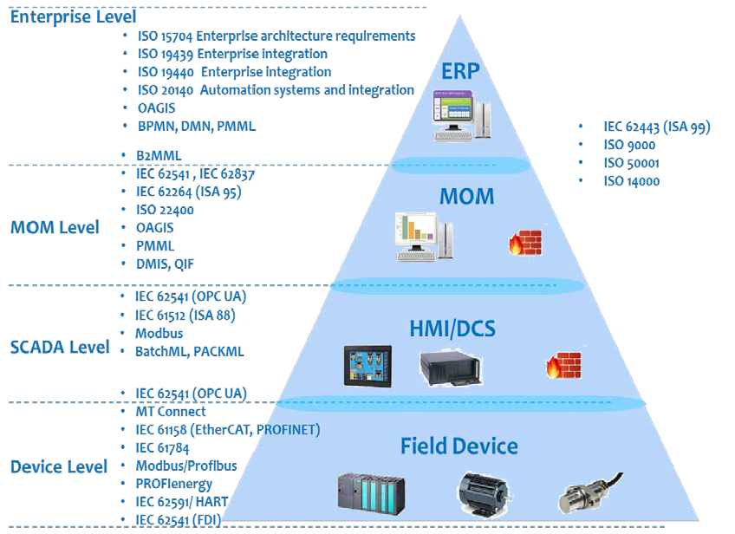
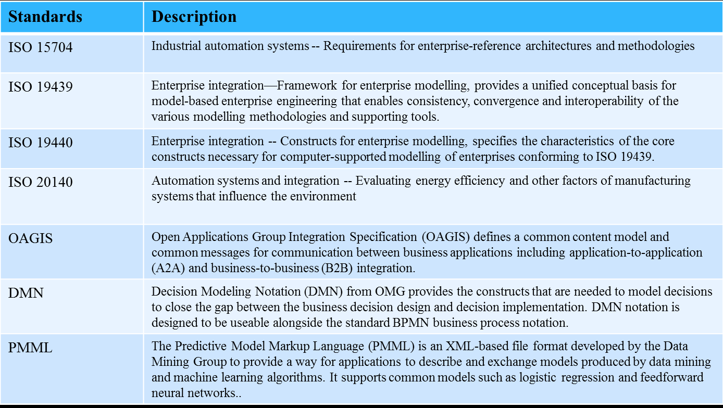
Standards set for vertical integration allow us to connect any solution one to another

Slide 10
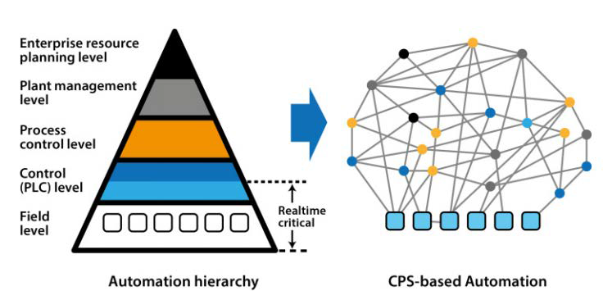
IIOT assumes movement to decentralized net-style connection architecture (SOA enabled)

Slide 11
Integration bring us to new "service" economy – Products as Services.
Non primary production processes
Service processes
Non-critical business processes

